Slide 1


The Syntax Detective Agency
Operation: Structural Integrity

Slide 2

Phase 1: Blueprint Analysis
Agent, grab your pencil. It's time to draw some trees.

Slide 3


Mission Brief #1: Structure Decoding
Your Orders:
We've intercepted two encrypted phrases. Your mission is to draw the appropriate tree diagrams for them.
Target A: "into the house"
Target B: "sent the flowers to Carla"

Slide 4
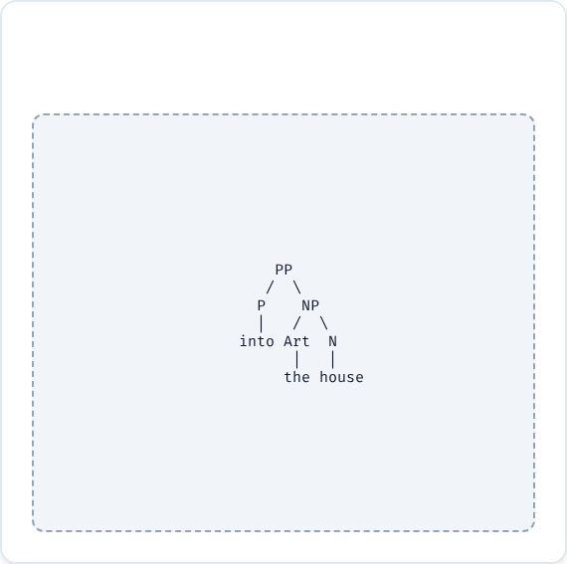
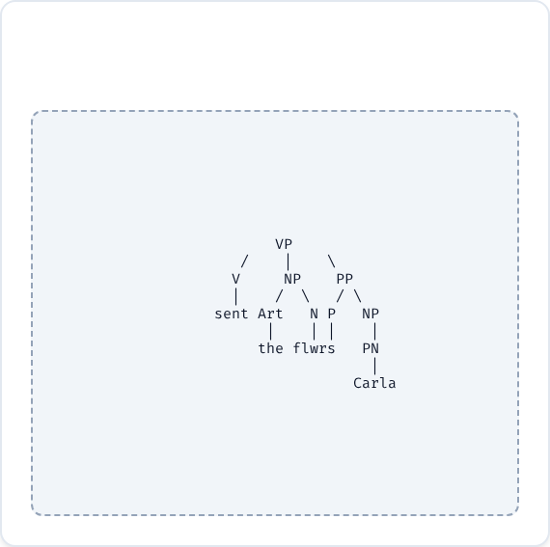
Mission Report: Targets A & B
Target A: PP Structure
Target B: VP Structure

Slide 5
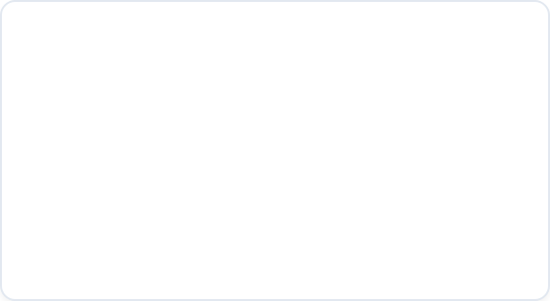
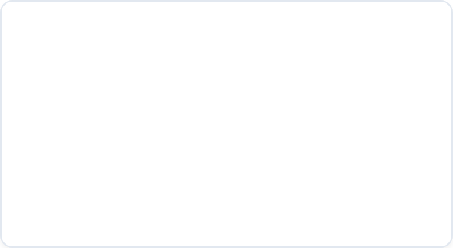


Mission Brief #2: Advanced Intel
Target C
Target D
"a film about pollution"
"went to the cinema yesterday"
Warning: Noun Phrase containing a Prepositional Phrase.
Warning: Verb Phrase modified by an Adverb.

Slide 6
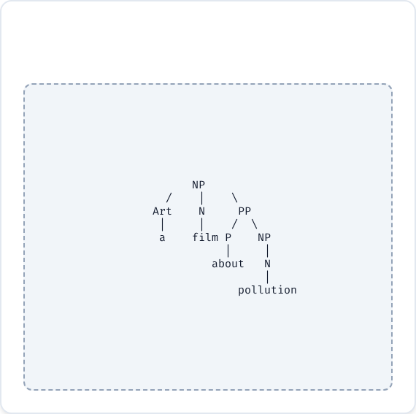
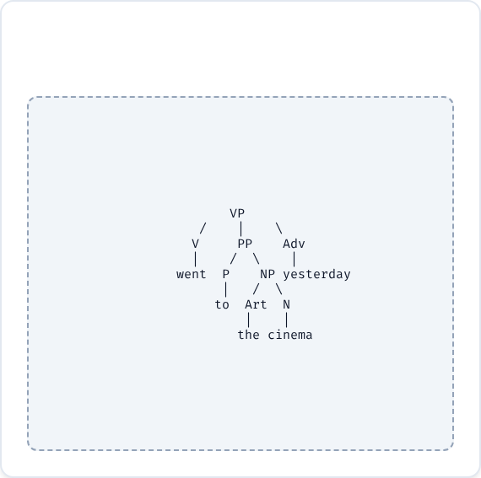
Mission Report: Targets C & D
Target C: NP Structure
Target D: VP Structure

Slide 7

Phase 2: The Ambiguity Files
Things aren't always what they seem. Decode the double meanings.

Slide 8
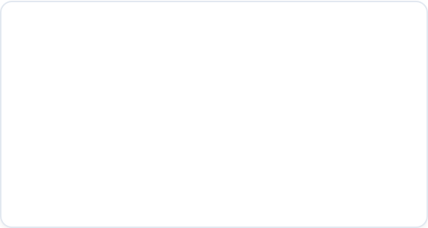
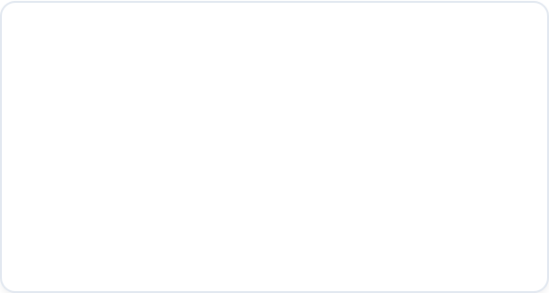


File #1: The Identity Crisis
"an American history teacher"
"Egyptian cotton shirts"
Is the teacher a patriot from the USA? Or do they teach the history of America?
Are the shirts made of Egyptian cotton? Or are the shirts from Egypt made of cotton?

Slide 9


Decoded: File #1
The Teacher
The Shirts
•
Meaning 1: A teacher of American history. (The subject is American History).
•
Meaning 1: Shirts made specifically from "Egyptian cotton".
•
Meaning 2: A teacher who is American and teaches history. (The teacher is American).
•
Meaning 2: Cotton shirts that originate from Egypt.

Slide 10
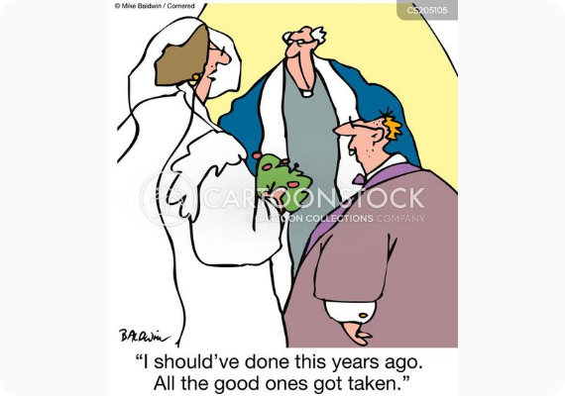
File #2: The Wedding Mixer
The Statement:
"The parents of the bride and the groom were waiting."
Who exactly was waiting in the lobby? Can you spot the two different groups?

Slide 11
Decoded: File #2
Option A: [Parents of the bride] + [Parents of the groom] (Two sets of parents are waiting) Option B: [Parents of the bride] + [The Groom] (The bride's parents and the groom himself are waiting)

Slide 12

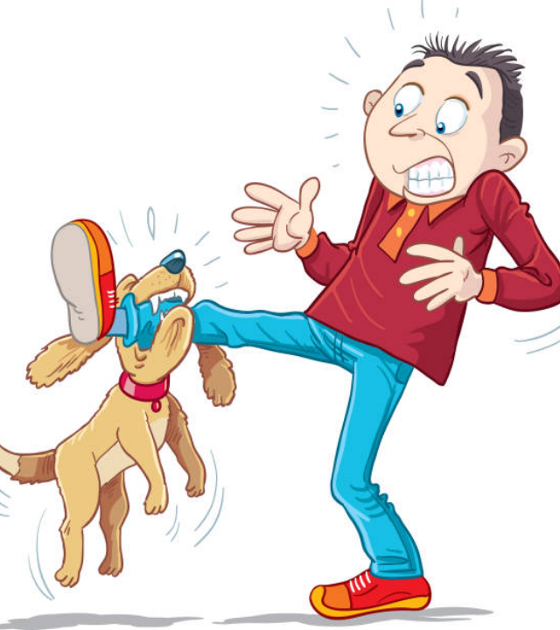
File #3: The Incident
"The dog bit the man in the car."
We need to establish the crime scene.
•
Was the man sitting inside a car when he was bitten?
•
Or did the dog bite the specific man who is known to be in the car?

Slide 13
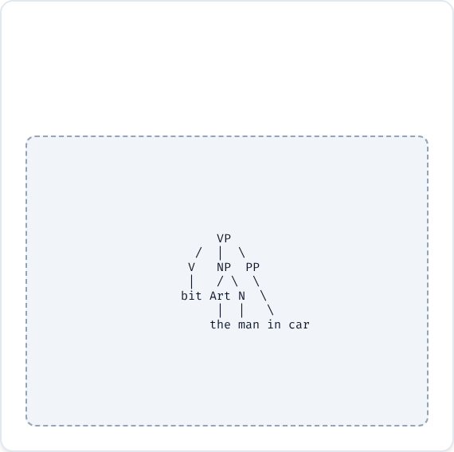
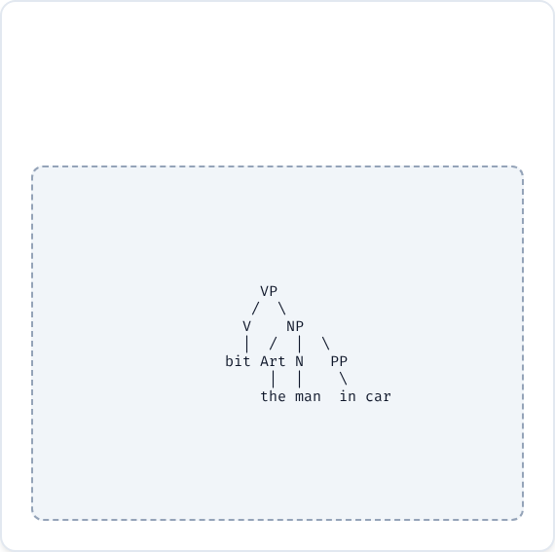
Evidence Board: File #3
Theory 1: Location
Theory 2: Identity
Action happened in the car.
The "man-in-the-car" was bitten.

Slide 14

File #4: The Magic Trick
"The magician touched the child with the wand."
A classic case of instrumental ambiguity.
•
Did the magician use the wand as a tool to touch the child?
•
Or did the magician touch a child who was holding a wand?

Slide 15
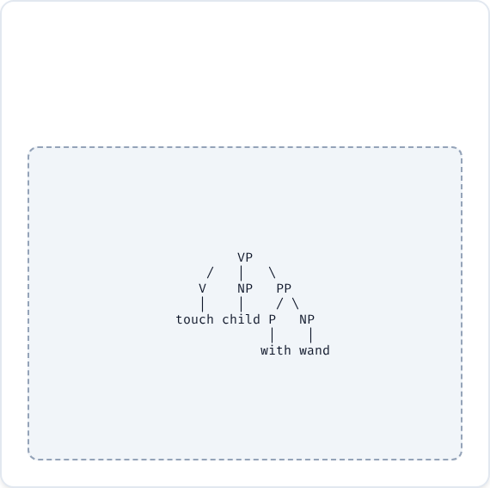
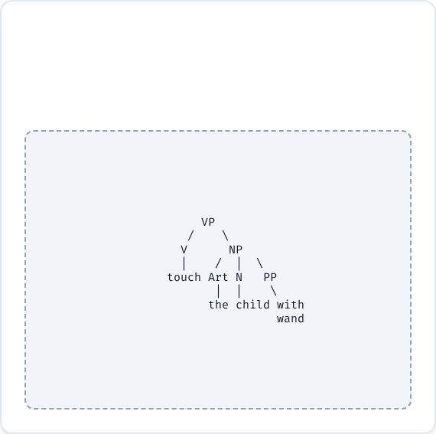
Evidence Board: File #4
Theory 1: Instrument
Theory 2: Possession
Using wand to touch.
Child holding wand.

Slide 16

Case Closed?
Any questions, detectives?

Slide 17





Image Sources
https://img.freepik.com/premium-vector/detective-looking-clues-with-magnifying-glass-white-background_1125697-55493.jpg
Source: www.freepik.com
https://s3.amazonaws.com/lowres.cartoonstock.com/marriage-relationships-wedding-wedding_day-choice-settling_down-waiting_too_long-mban1372_low.jpg
Source: www.cartoonstock.com
https://media.istockphoto.com/id/1126092832/vector/the-dog-bites-a-man.jpg?s=612x612&w=0&k=20&c=2GaT4Jbsml64jh_VcYGMkCz4JCvEI_ACqvhIBKcPQ98=
Source: www.istockphoto.com
https://en.pimg.jp/043/428/420/1/43428420.jpg
Source: tw.pixtastock.com

